Slide 1

CSS
Lesson 3

Slide 2
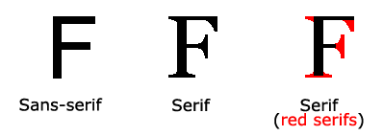
CSS Font
Property | Description
font | Sets all the font properties in one declaration
font-family | Specifies the font family for text
font-size | Specifies the font size of text
font-style | Specifies the font style for text
font-variant | Specifies whether or not a text should be displayed in a small-caps font
font-weight | Specifies the weight of a font

Slide 3
CSS Font
Font-family
generic family - a group of font families with a similar look (like "Serif" or "Monospace")
font family - a specific font family (like "Times New Roman" or "Arial")
Generic family | Font family | Description
Serif | Times New Roman Georgia | Serif fonts have small lines at the ends on some characters
Sans-serif | Arial Verdana | "Sans" means without - these fonts do not have the lines at the ends of characters
Monospace | Courier New Lucida Console | All monospace characters have the same width

Slide 4
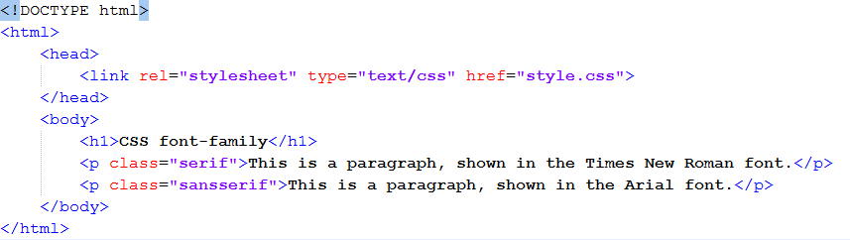
CSS Font
Font-family
style.css
doc.html

Slide 5

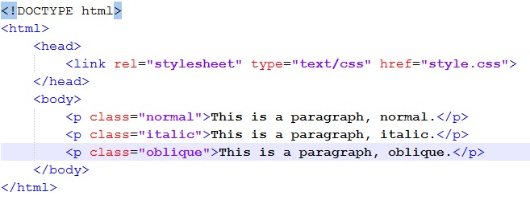
CSS Font
Font-style
style.css
doc.html

Slide 6

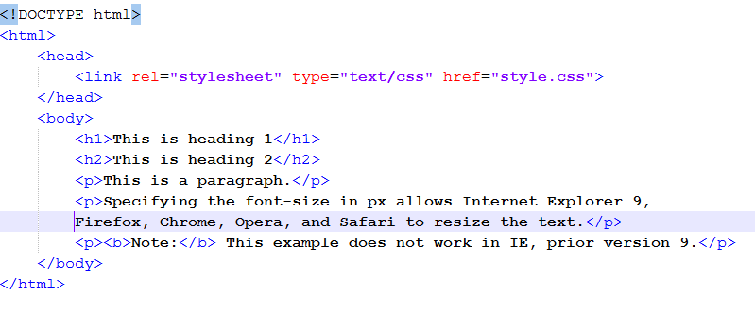
CSS Font
Font-size with pixels
style.css
doc.html

Slide 7

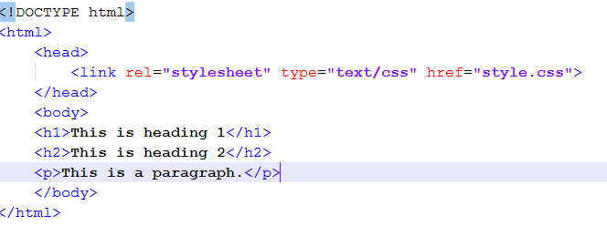
CSS Font
pixels/16=em
Font-size with ems
style.css
doc.html

Slide 8
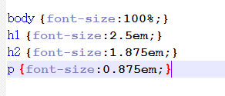
CSS Font
Font-size with ems and percents
style.css
doc.html

Slide 9


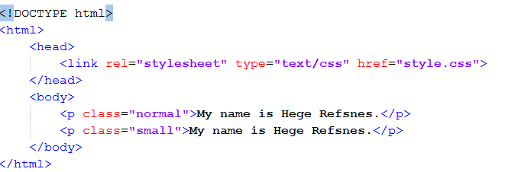
CSS Font
Font-variant
style.css
doc.html

Slide 10
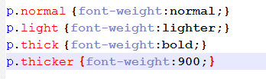
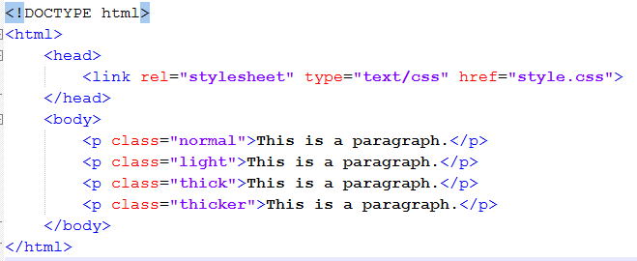
CSS Font
Font-weight
style.css
doc.html

Slide 11

Task1:
Task2:

Slide 12
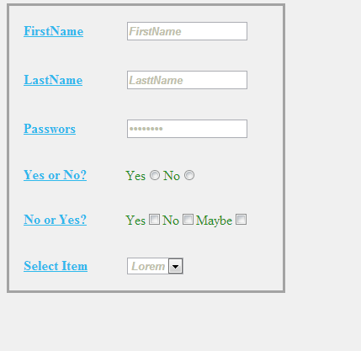
Task3:

Slide 13

Task4:

